Slide 1
Random JokesApp
Wireframe Documentation

Slide 2
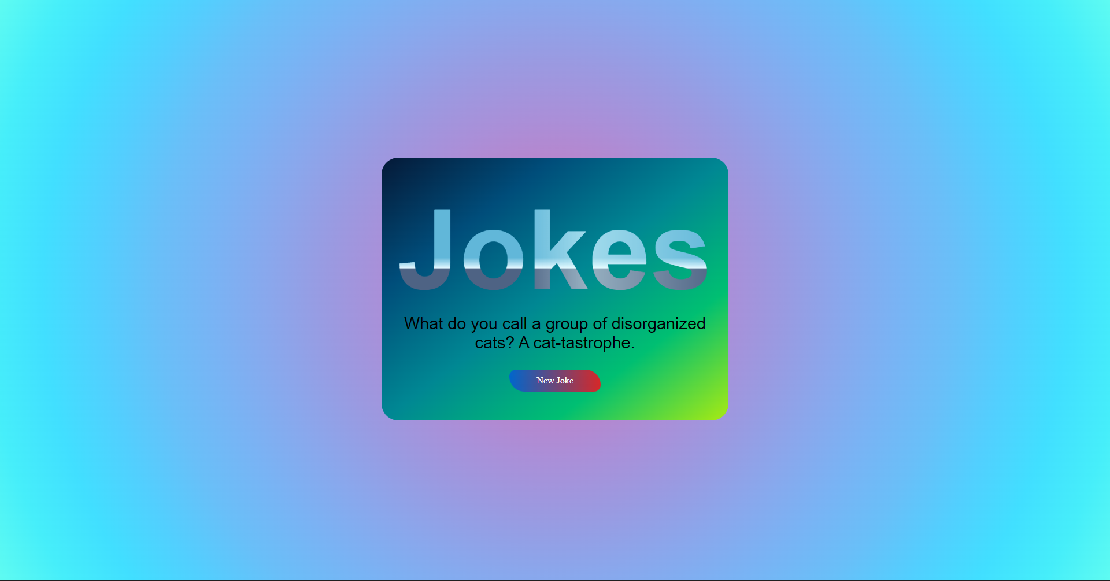
Homepage
The homepage will display a single button labeled "Generate Joke".
When the user clicks the button, a new joke will be generated and displayed on the page.

Slide 3
Joke Display
The joke will be displayed in a large, centered text box.
The joke will be formatted as a question and answer, with the question displayed in bold.
Below the joke, there will be a button labeled "Next Joke".
When the user clicks the "Next Joke" button, a new joke will be generated and displayed.

Slide 4
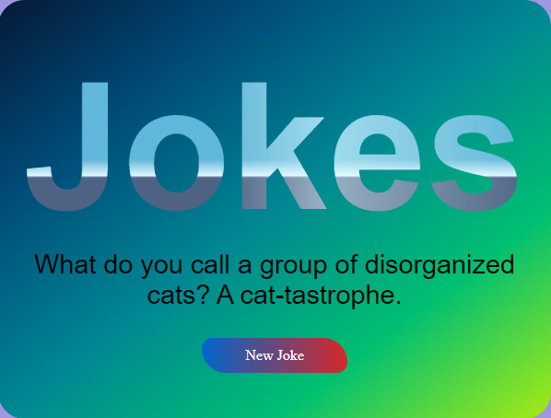
Centered Text Box

